Slide 1
LEONTREE project background
Experimental Working Group meeting
October 26, 2021

Slide 2
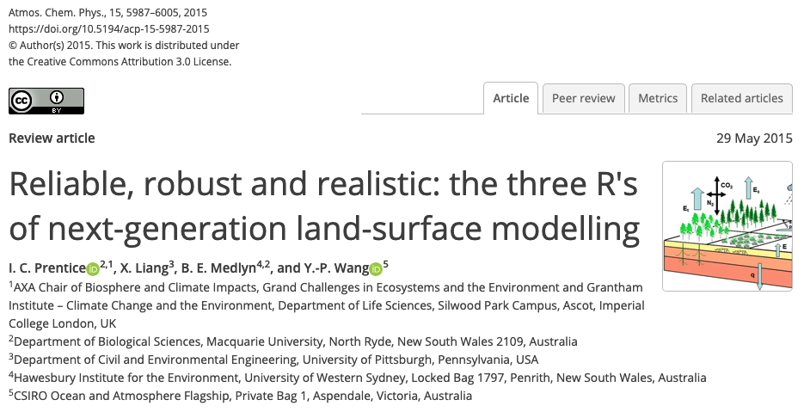

Slide 3
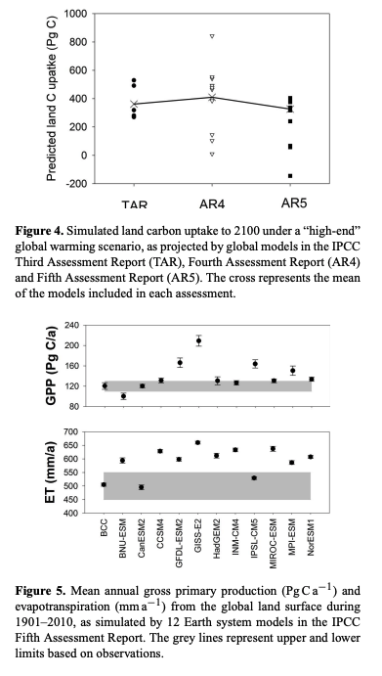
Models have undergone improvements to ”realism” at the expense of robustness and reliability…yet are still no good!

Slide 4
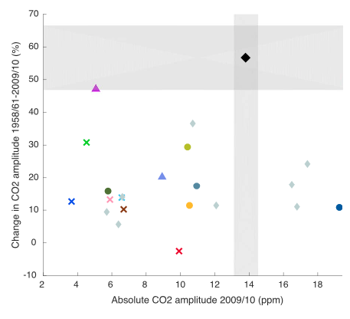

Slide 5
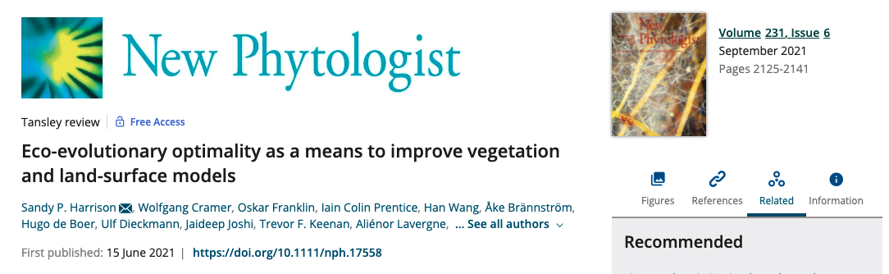

Slide 6
Optimality theory provides an avenue for improving model realism without sacrificing reliability

Slide 7
Land Ecosystem Models based On New Theory, obseRvations, and ExperimEnts (LEMONTREE)

Slide 8
“We propose to develop a next-generation model of the terrestrial biosphere and its interactions with the carbon cycle, water cycle and climate. Our revolutionary approach will lead to ecosystem models that rest on firm theoretical and empirical foundations, and eventually, more reliable projections of future climates.”

Slide 9
LEMONTREE pillars
New data-rich world
Eco-evolutionary optimality principle
Natural selection rapidly eliminates uncompetitive trait combinations
Targeted experiments

Slide 10
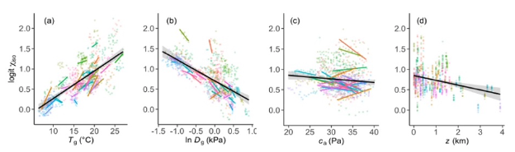
LEMONTREE strategy
Use observational and experimental data in a “strong inference” framework whereby optimality hypotheses are explicitly formulated and tested one-by-one

Slide 11
LEMONTREE challenges
Develop a comprehensive “optimal trait theory” predicting the leading dimensions of variation in the functional morphology of plants
Construct a land surface model for water, energy, and momentum changes with the atmosphere that will reproduce observations
Construct a model for land carbon cycling that will reproduce observed seasonal and interannual variations in carbon fluxes and pools
Couple a new land surface model to an Earth System Model

Slide 12
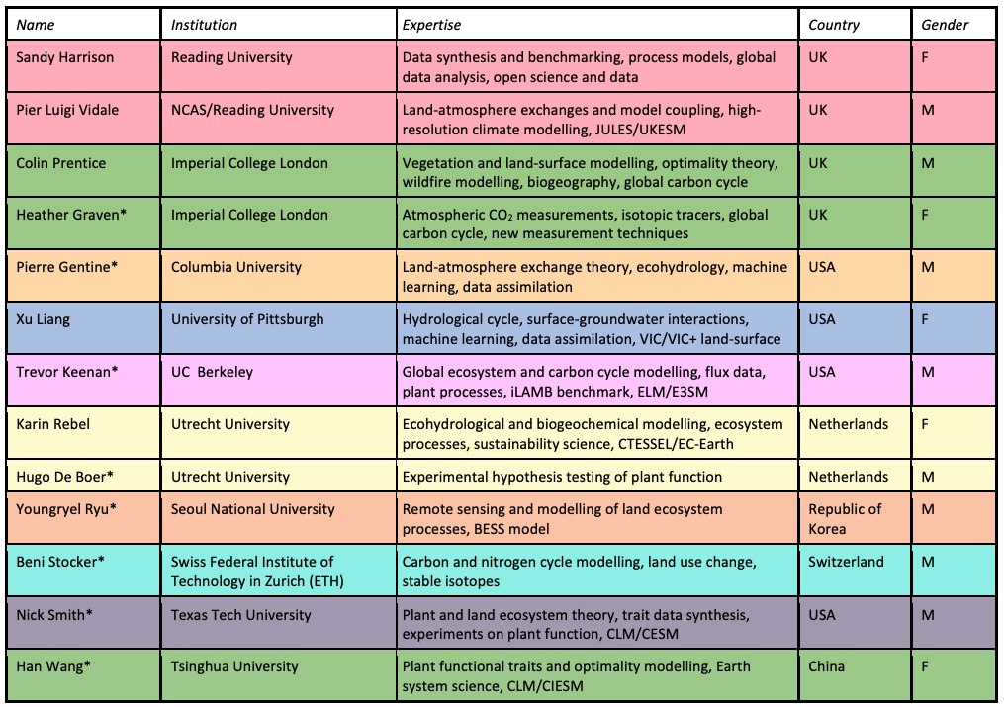

Slide 13
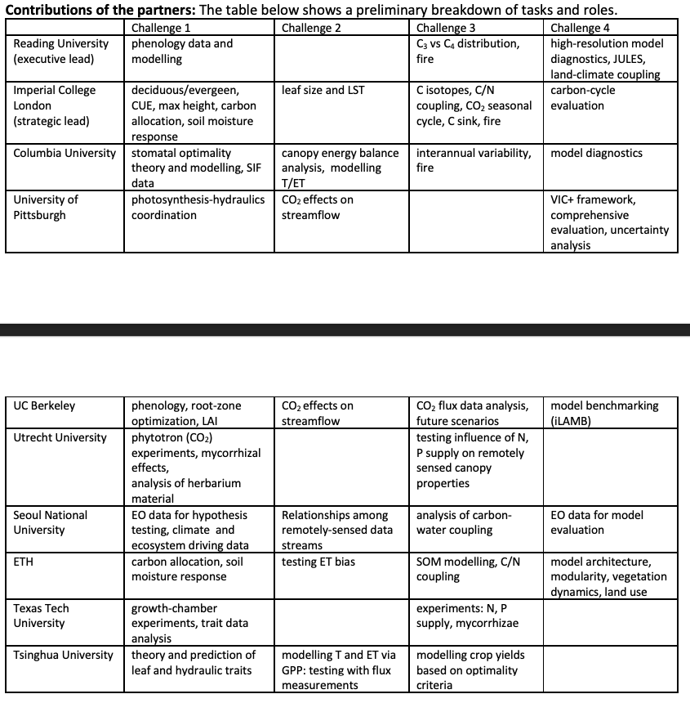
*Also collaborating with modeling groups and ESRI core team for project support

